Slide 1
JD Insights & RESUME MATCHER
Regina Cheong

Slide 2


AIMS
JD insights for Hiring Managers
Resume writing tips for applicants
Data
Kaggle Data Scientist Job Market in the U.S. (7000 rows)
Processing
Punctuation
Topic Modelling
Tips
Resume Match
Insights
Lower-case
Tokenized
Stop words
Stemming

Slide 3

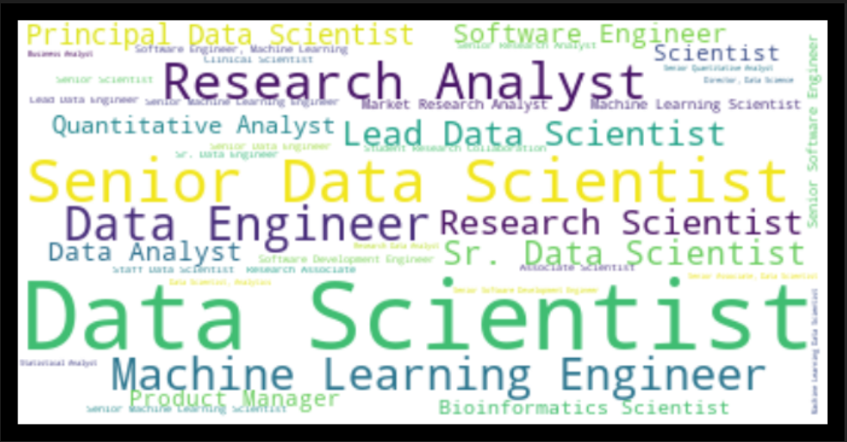
Titles

Slide 4
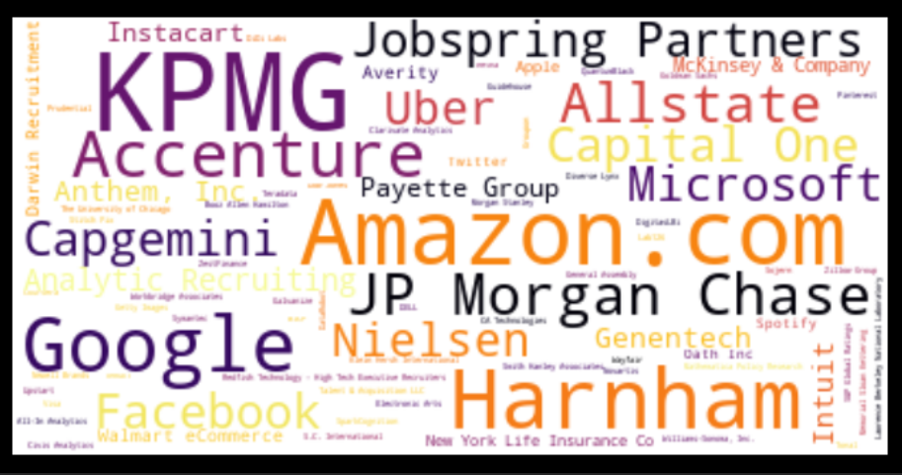
Major employers [~1400 data sets]
Investment Banks & Financial houses
Consulting & Research
Specialized Recruiting Agencies
Big 4 Tech Co (Google, FB, Amazon, Microsoft)

Slide 5
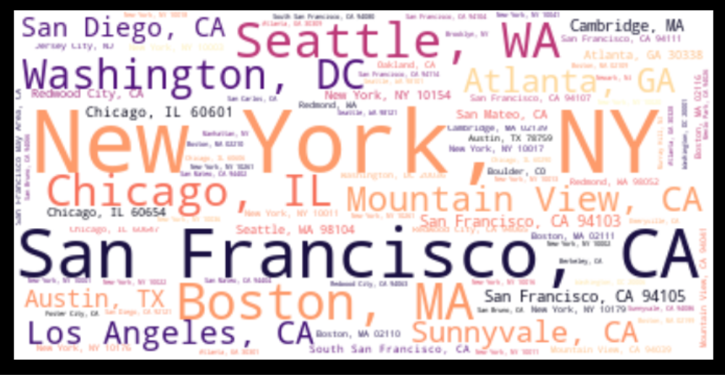
Most opportunities [~1400 data sets]

Slide 6
4 Topics

Slide 7
TOPICS 4 Topics SOLO AND “COUPLE” WORDS
CountVectorizer
1. Latent semantic analysis (LSA)
2. Non-Negative Matrix Factorization (NMF)
TF-IDF [term frequency–inverse document frequency]
1. LSA
2. NMF
Notes:
CV counts the frequency of the terms occurrence; TF-IDF does the same but normalize over the lengths of doc and give weight to rare terms.
LSA & NMF are different ways of breaking down the term – document matrix into composite for topic modelling.

Slide 8
“X” OVERDOSE [ → ~1200]
kpmg, lighthous, kpmg lighthous, lighthous kpmg, excel advanc, center excel, consid employ, statu, ai, employ qualifi, center, divers, firm, viewpoint, sentiment, legal, qualifi applic, cognit, consid, array, abil pregnanc, age sexgend, affili legal, local state, packag kpmg, firm kpmg, statu unfavor, mental handicap, ordin number, workplac kpmg, 131192, 131192 phone, unfavor, number 131192, sexgend nation, unrel abil, statu kpmg, applic local, unfavor discharg, call agenc, kpmg llp, kpmg maintain, francisco ordin, discharg militari, appear famili, kpmg intern, kpmg consid, kpmg equal, kpmg current, respons matricul, handicap unrel, servic genet, pregnanc veteran, llp us, member firm, us member, law includ, matricul polit, matricul, intern offer

Slide 9
1. Employer environment [ Embrace diversity]
googl, usa, resum, analysi, ca usa, googl engin, regardless, accept, engin, data, agenc, experi, product, eg, qualif, busi recommend, ca, pleas, applic, recommend, statu, work, achiev anoth, technolog achiev, youtub, world one, one technolog, user, employe, quantit, googl accept, know recruit, requir disabl, agenc googl, differ celebr, resum job, thrive benefit, celebr support, dont accept, support thrive, workplac affirm, commun googl, accept differ, locat googl, googl respons, googl proud, alia googl, googl dont, minimum qualif, chang world, alia, job alia, statu also, busi, accept agenc, accommod pleas, disabl, disabl special, special need, employe compani

Slide 10
2. goals / misconceptions [realistic?]
accentur, chain, suppli chain, suppli, client, visa, employ, client pivot, analyt, pivot, statu, help client, choos, analyt algorithm, digit, industri, network, simul, advanc, author, pivot new, digit digit, app innov, network 1800, chain unpreced, augment power, think digit, proprietari advanc, studio rapidli, becom industri, act learn, digit core, readi choos, academ allianc, algorithm sens, power human, scale network, speed scale, patent app, across valu, disruptorsw help, disruptorsw, core readi, allianc patent, 1800, pivot think, lab studio, new leverag, sens comprehend, concept acceler, test proof, comprehend act, 1800 data, industri disruptorsw, client becom, ai proprietari, unpreced speed, human artifici, acceler time, time market

Slide 11
3. Stakeholders [no man is an island]
capgemini, client, amp, data, scienc amp, ect, amp analyt, applic, sap, group, analyt, practic group, amp entertain, media amp, digit, employ, experi, busi, articul, requir, global, sector, group capgemini, client execut, digit practic, find client, grow digit, 2017, consult, servic, practic, media, data number, articul find, analyt practic, author, scienc, work, life scienc, entertain, client engag, analyt group, capgemini global, clearli articul, build scalabl, group report, sentiment analysi, perform, solut, design, sentiment, data scienc, regress, must valid, us capgemini, author us, public sector, eg, gener, valid work

Slide 12
4. Skills & experience [TECH SKILLS REQUIRED]
data, experi, busi, work, team, analyt, learn, model, develop, scienc, product, machin, statist, machin learn, data scienc, use, custom, skill, build, scientist, analysi, data scientist, solut, manag, compani, engin, new, requir, project, research, technolog, abil, process, insight, year, commun, strong, includ, problem, market, help, techniqu, comput, algorithm, appli, design, tool, advanc, understand, opportun, lead, client, predict, provid, applic, support, etc, system, respons, set

Slide 13
MATCHER

Slide 14
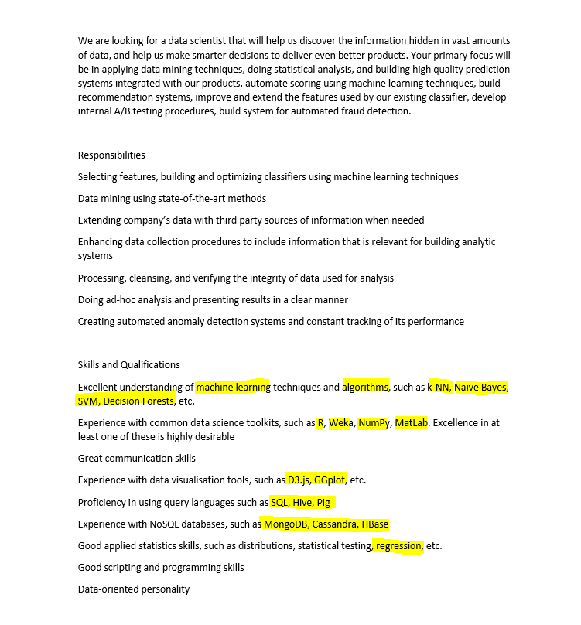
Search for the best candidates
Focus on the skills section of the JD and the candidate resumes, selecting </= 80 words

Slide 15
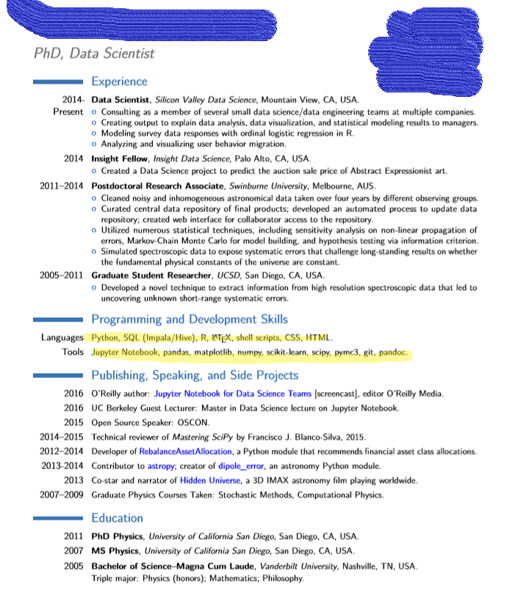
Search for the best candidates
Focus on the skills section of the JD and the candidate resumes, selecting </= 80 words
Candidate 1
PhD Data Scientist
Minimum inputs in Skills
Candidate 2
PhD Data Scientist
Candidate 3
No PhD
Customized CV
Minimum inputs in Skills

Slide 16
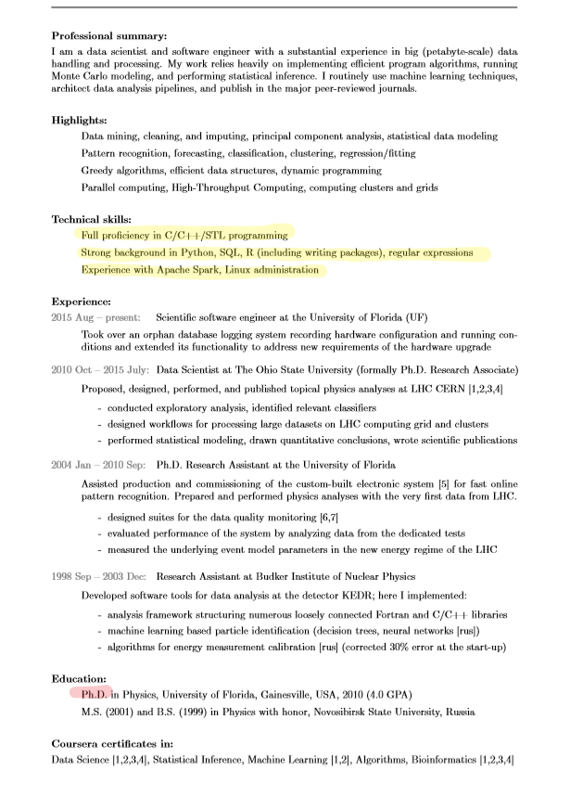
Search for the best candidates
Focus on the skills section of the JD and the candidate resumes, selecting </= 80 words
Candidate 1
PhD Data Scientist
Candidate 2
PhD Data Scientist
Candidate 3
No PhD
Customized CV
Minimum inputs in Skills
Minimum inputs in Skills

Slide 17
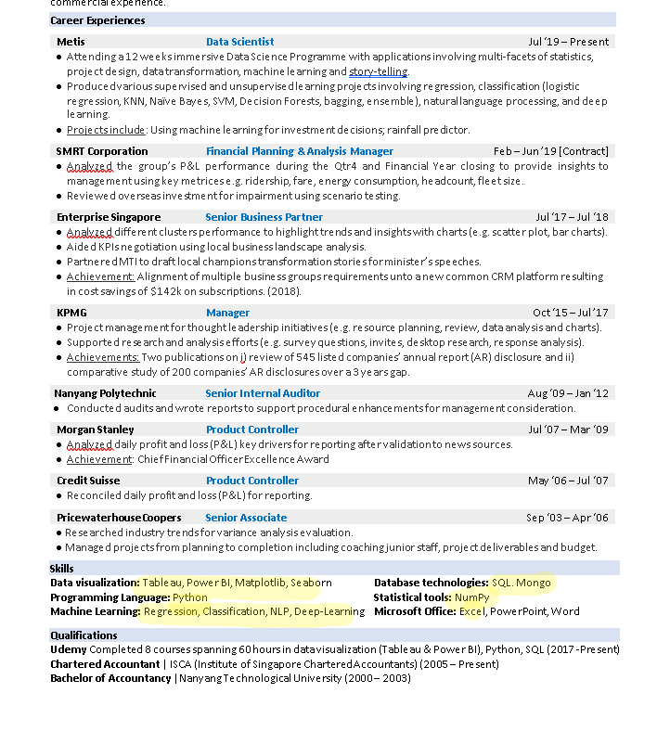
Search for the best candidates
Focus on the skills section of the JD and the candidate resumes, selecting </= 80 words
Candidate 1
PhD Data Scientist
Candidate 2
PhD Data Scientist
Candidate 3
No PhD
Customized CV
Minimum inputs in Skills
Minimum inputs in Skills

Slide 18
Search for the best candidates
Focus on the skills section of the JD and the candidate resumes, selecting </= 80 words
Candidate 1
PhD Data Scientist
Candidate 2
PhD Data Scientist
Candidate 3
No PhD
Customized CV
Minimum inputs in Skills
Minimum inputs in Skills
0.08
0.08

Slide 19
IT IS IMPORTANT TO CUSTOMIZE YOUR RESUMe
Candidate 1
PhD Data Scientist
Candidate 2
PhD Data Scientist
Candidate 3
No PhD
Customized CV
Minimum inputs in Skills
Minimum inputs in Skills
0.08
0.08
0.2

Slide 20
Future works
Extend the skills similarity match to also experience and education
Build an inventory of CV for creating a recommender systems

Slide 21
Q&A

Slide 22

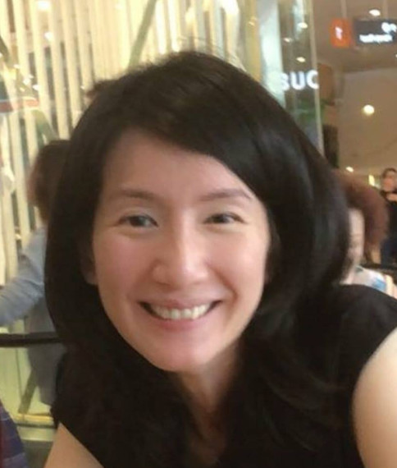



Regina cheong
https://github.com/1Regina
https://www.linkedin.com/in/regina-cheong/

